Slide 1


BANK NOTE AUTHENTICATION

Slide 2
Presented by
NAME:D.DURGAPRASAD
HALL NO:2203A52146
S.NO:39
TO:
Ramesh sir
Faculty of statml
SECTION:CSE(AI&ML)AA SECTION

Slide 3
INTRODUCTION
Typically, people accept banknotes as change from another person or at a point-of-sale without consciously verifying authenticity (Klöne et al., 2019). Reasons for not checking authenticity are that counterfeit rates are extremely low, and that people trust the retailer (van der Horst et al., 2017a). Indeed, authentication may take place in a limited number of cases; for example, when the cash handler has encountered counterfeit banknotes before, or when the paper of a particular note feels somewhat unusual. Also, when one does not trust a particular transaction (e.g. an online purchase involving cash) one may check the authenticity of the banknote. A more practical constraint is that the general public has little knowledge of how to authenticate banknotes. On average, a person can mention two security features, but does not know what these features look like exactly, and where on a banknote these features may be found (van der Horst et al., 2017a). For instance, 69% of the general public knows that a euro banknote contains a watermark, but only 6% knows what image the watermark depicts (De Nederlandsche Bank, 2021a, 2021b). The next most known security feature is the hologram foil, mentioned by 39% of the public. The emerald number can be recalled only by 2% of participants.

Slide 4
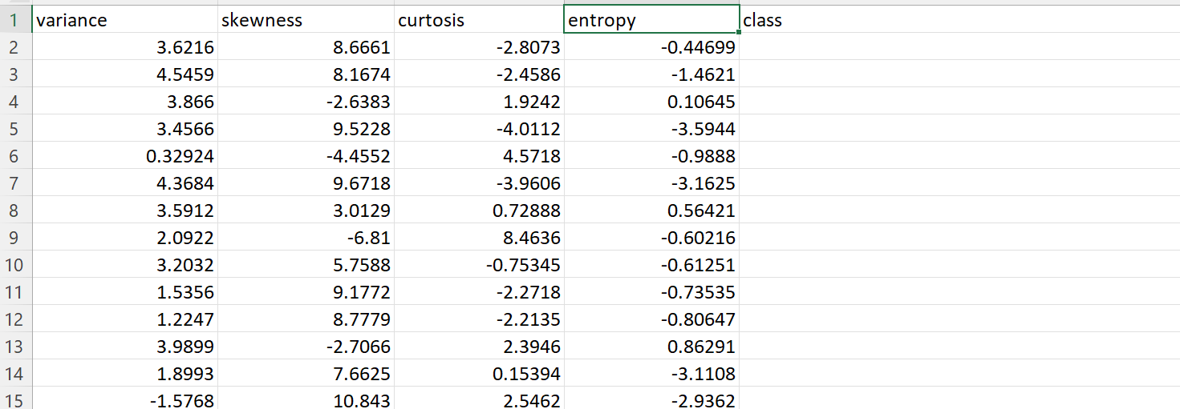
Data Set

Slide 5
Data set
Attributes
Variance
Skewness
Curtosis
Entropy
Class

Slide 6
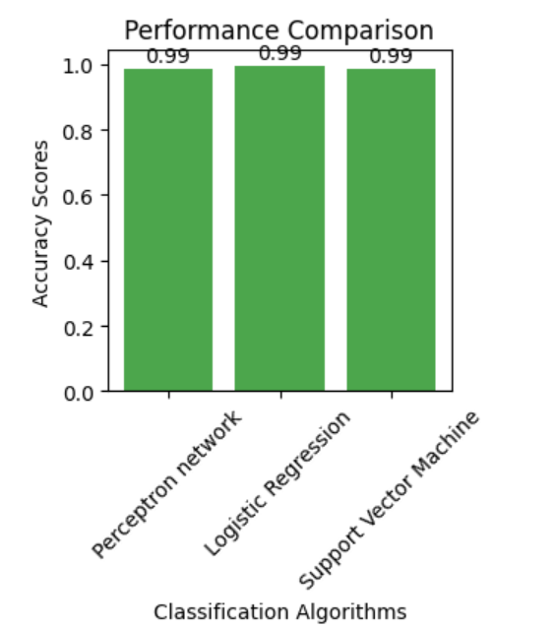
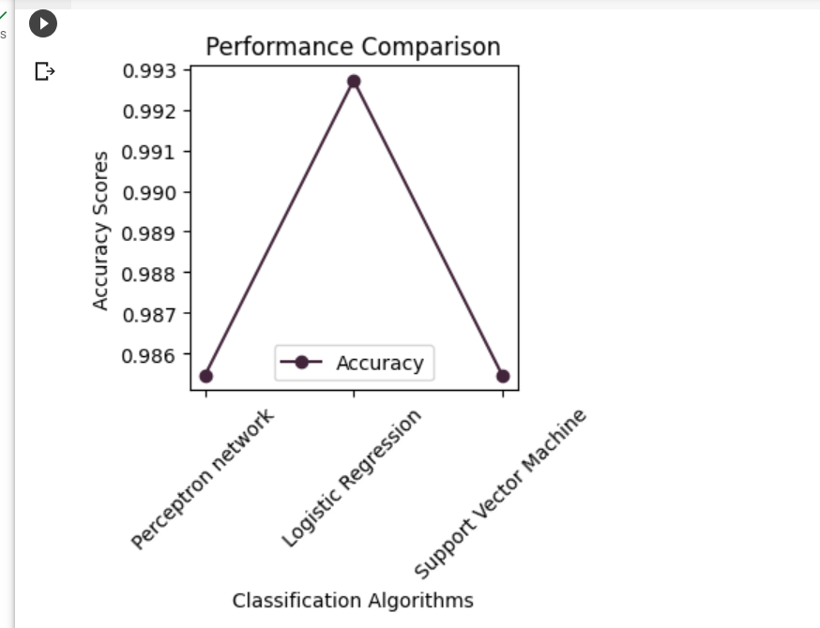
Graphs

Slide 7
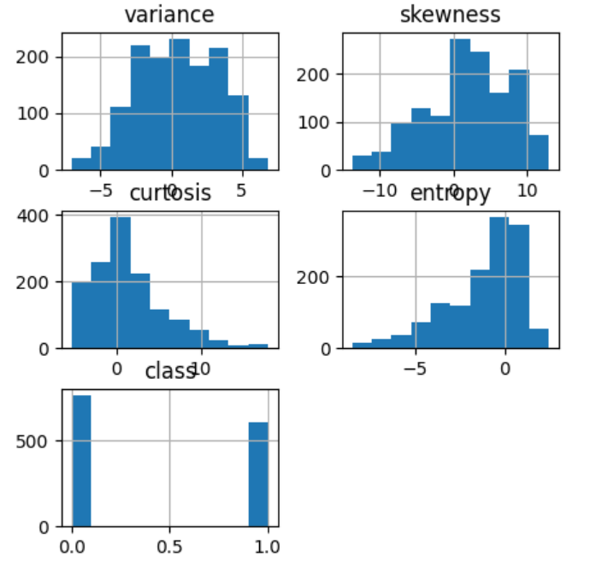
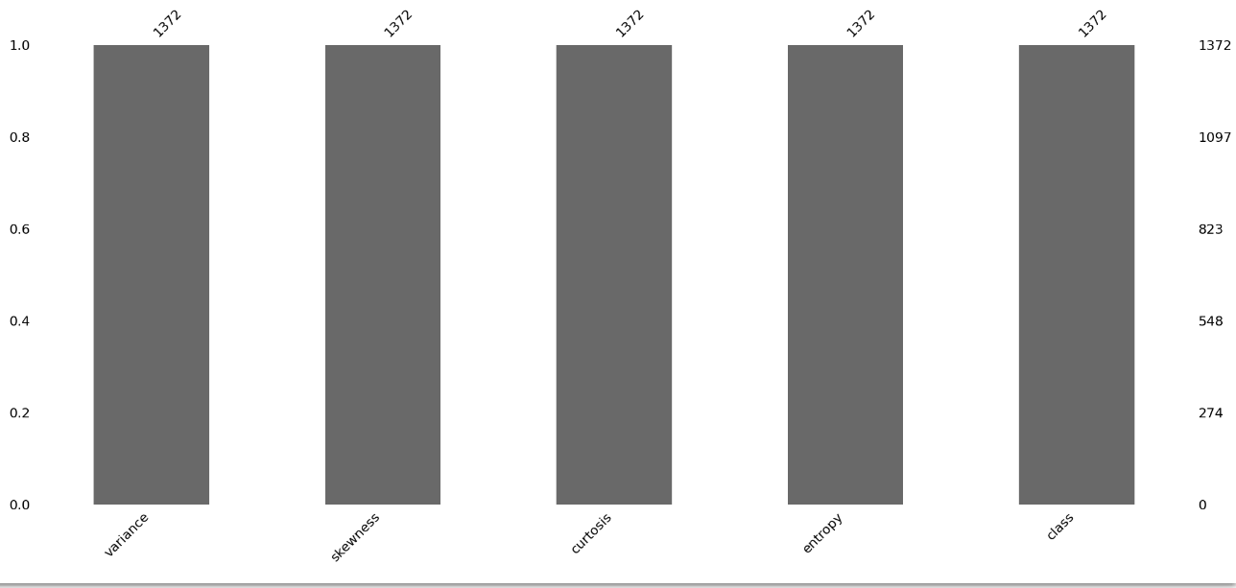

Slide 8
APPROACH
The approach that we are using in Bank note authentication and analysis is CLASSIFICATION
Classification algorithm is a Supervised Learning technique that is used to identify the category of new observations on the basis of training data. In Classification, a program learns from the given dataset or observations and then classifies new observation into a number of classes or groups. Classes can be called as targets/labels or categories.
In bank note authentication analysis and prediction data set we have 13 independent variables(x) and one dependent variable(y)

Slide 9
IMPLEMENTATION
Supervised Learning
Parametric Approach
Classification
Logistical Regression
Perceptron Learning
Support Vector Machine

Slide 10
LOGISTIC REGRESSION
Logistic regression is a supervised machine learning algorithm.
This type of statistical model ,is often used for classification and predictive analytics. Logistic regression estimates the probability of an event occurring, such as voted or didn’t vote, based on a given dataset of independent variables. Since the outcome is a probability, the dependent variable is bounded between 0 and 1. In logistic regression, a logit transformation is applied on the odds—that is, the probability of success divided by the probability of failure

Slide 11
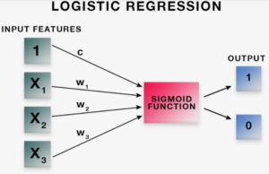
LOGISTIC REGRESSION

Slide 12
K-NEAREST NEIGHBOURS
KNN is a non-parametric machine learning algorithm. The KNN algorithm is a supervised learning method. This means that all the data is labelled and the algorithm learns to predict the output from the input data. It performs well even if the training data is large and contains noisy values. The data is divided into training and test sets. The train set is used for model building and training. Ak- value is decided which is often the square root of the number of observations. Now the test data is predicted on the model built. There are different distance measures. For continuous variables, Euclidean distance, Manhattan distance and Minkowski distance measures can be used.

Slide 13
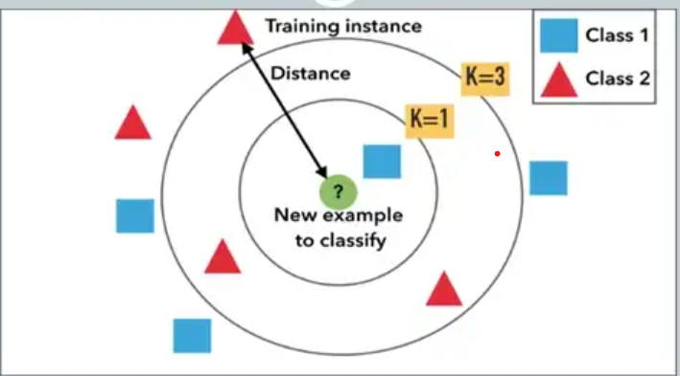

Slide 14
import pandas as pd
d=pd.read_csv('/content/BankNote_Authentication.csv')
print(d)
y=d['class']
x=d.drop('class',axis=1)
print(y)
print(x)
from sklearn.model_selection import train_test_split
x_train,x_test,y_train,y_test=train_test_split(x,y,test_size=0.20,random_state=20)
print(x_train.shape,y_train.shape)

Slide 15
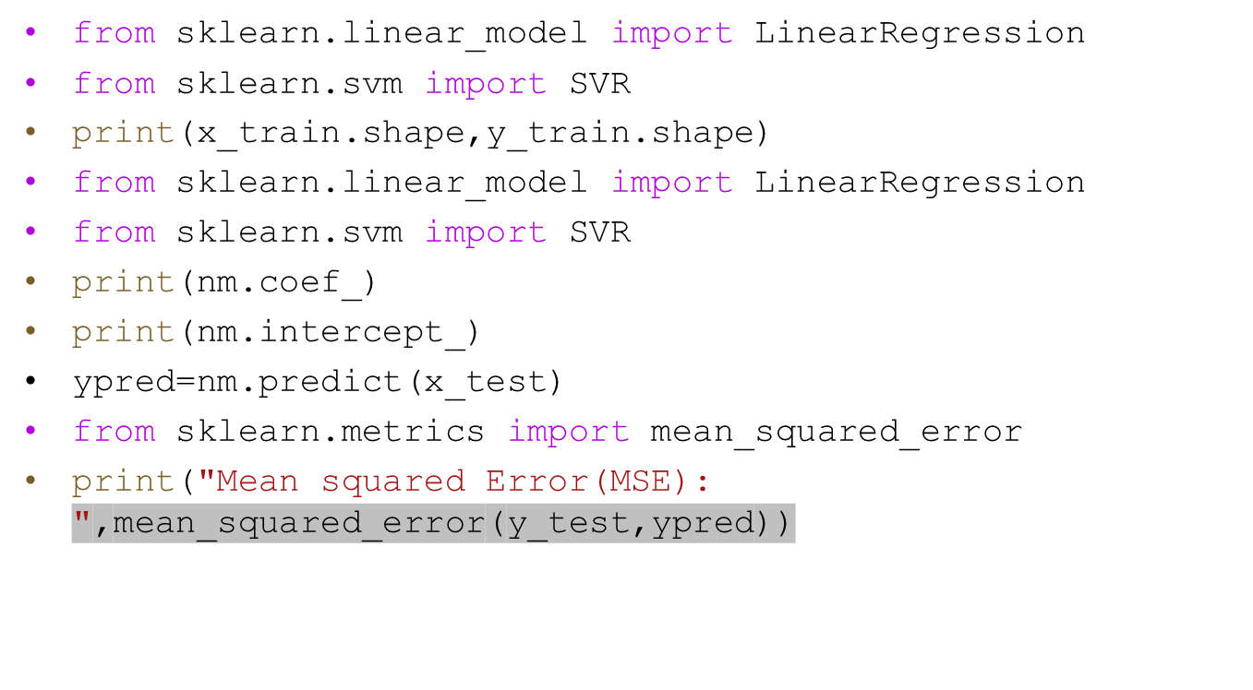

Slide 16
from sklearn.model_selection import train_test_split
from sklearn.svm import SVC
from sklearn.metrics import accuracy_score
import matplotlib.pyplot as plt
svm = SVC(kernel='linear', C=1, random_state=42)
svm.fit(x_train, y_train)
y_pred = svm.predict(x_test)
print(y_pred)

Slide 17
algorithm_names = ['Perceptron network','Logistic Regression','Support Vector Machine']
accuracy_scores = [ accuracy , accuracy_LR , accuracy_SVM ]
# Plotting the scores
plt.figure( figsize = ( 3, 3 ) )
# Accuracy scores plot
plt.plot(algorithm_names, accuracy_scores, label = 'Accuracy', marker = 'o', color = '#42253B')
plt.xlabel( 'Classification Algorithms' )
plt.ylabel( 'Accuracy Scores' )
plt.title( 'Performance Comparison' )

Slide 18
# Adding a legend
plt.legend()
# Rotating the x-axis labels for better visibility
plt.xticks( rotation = 45 )
# Displaying the plot
plt.show()
import matplotlib.pyplot as plt
algorithm_names = ['Perceptron network', 'Logistic Regression', 'Support Vector Machine']
accuracy_scores = [accuracy, accuracy_LR, accuracy_SVM]

Slide 19
plt.figure(figsize=(3, 3))
# Bar chart for accuracy scores
plt.bar(algorithm_names, accuracy_scores, color='Green', alpha=0.7)
plt.xlabel('Classification Algorithms')
plt.ylabel('Accuracy Scores')
plt.title('Performance Comparison')
# Adding data labels
for i, v in enumerate(accuracy_scores):
plt.text(i, v + 0.01, str(round(v, 2)), ha='center', va='bottom')

Slide 20
The methods of classifications used in this project gives
accurate results from the data
These two are techniques used in the present project
accurate results
Therefore logistic regression and KNN are used for the
bank note authentication analysis and prediction

Slide 21
Bootsrapping
Bootstrapping is a statistical resampling technique that can be used for various applications, including banknote authentication. When it comes to banknote authentication, bootstrapping can be employed to assess the reliability and accuracy of a classification or authentication model. Here's how bootstrapping can be used for banknote authentication:
Data Collection: First, you need a dataset of banknote images or features. This dataset should include genuine and counterfeit banknotes. Each data point should have relevant features, such as color, texture, security features, etc.
Data Splitting: Divide your dataset into a training set and a testing set. The training set will be used to build your authentication model, while the testing set will be used to evaluate its performance.
Model Building: You can use machine learning or deep learning techniques to build a banknote authentication model. Common algorithms for this task include support vector machines, decision trees, random forests, and neural networks. Train the model on your training data.

Slide 22
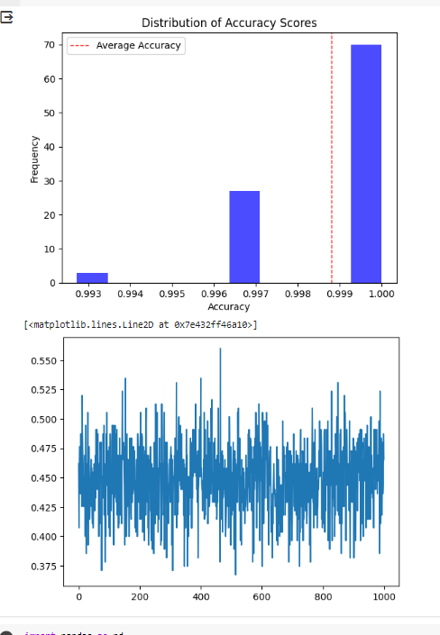
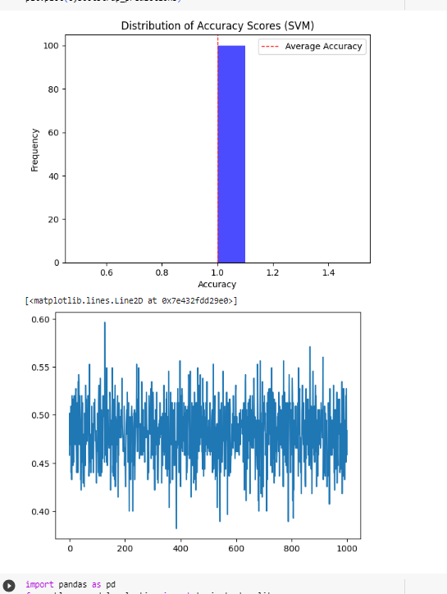
Bootstrapping for knn
Bootstrapping for svm

Slide 23
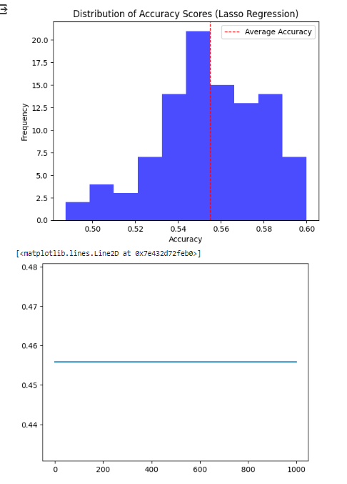
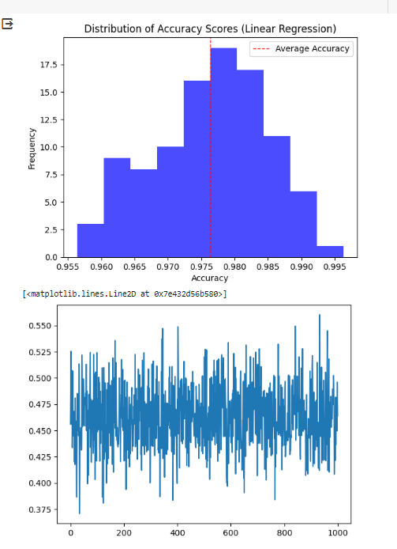
Bootstrapping for lasso
Bootstrapping for linear regression

Slide 24
conclusion
Banknote authentication is an important task. It is difficult to manually detect fake bank notes. Machine learning algorithms can help in this regard. In this article, we explained how we solved the problem of banknote authentication using machine learning techniques. We compared three different algorithms in terms of performance and concluded that the Random Forest algorithms is the best algorithm for banknote authentication with an accuracy of 99.63%.

Slide 25
git hub link

